Slide 1

Software Engineering and Process Framework

Slide 2
Chapter 2
Software Engineering
Slide Set to accompany
Software Engineering: A Practitioner’s Approach, 8/e
by Roger S. Pressman and Bruce R. Maxim
Slides copyright © 1996, 2001, 2005, 2009, 2014 by Roger S. Pressman
For non-profit educational use only
May be reproduced ONLY for student use at the university level when used in conjunction with Software Engineering: A Practitioner's Approach, 8/e. Any other reproduction or use is prohibited without the express written permission of the author.
All copyright information MUST appear if these slides are posted on a website for student use.
These slides are designed to accompany Software Engineering: A Practitioner’s Approach, 8/e
(McGraw-Hill 2014). Slides copyright 2014 by Roger Pressman.

Slide 3
Software Engineering
Some realities:
a concerted effort should be made to understand the problem before a software solution is developed
design becomes a pivotal activity software should exhibit high quality, software should be maintainable
■
The seminal definition:
[Software engineering is] the establishment and use of sound engineering principles in order to obtain economically software that is reliable and works efficiently on real machines.
These slides are designed to accompany Software Engineering: A Practitioner’s Approach, 8/e
(McGraw-Hill 2014). Slides copyright 2014 by Roger Pressman.

Slide 4
Software Engineering
The IEEE definition:
Software Engineering:
  The application of a systematic, disciplined, quantifiable approach to the development, operation, and maintenance of software; that is, the application of engineering to software.
  The study of approaches as in (1).
These slides are designed to accompany Software Engineering: A Practitioner’s Approach, 8/e
(McGraw-Hill 2014). Slides copyright 2014 by Roger Pressman.

Slide 5
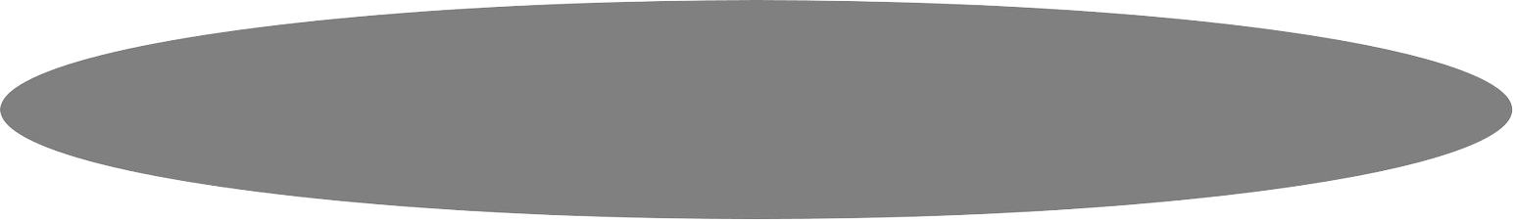



A Layered Technology
tools
methods process model
a “quality” focus
Software Engineering
These slides are designed to accompany Software Engineering: A Practitioner’s Approach, 8/e
(McGraw-Hill 2014). Slides copyright 2014 by Roger Pressman.

Slide 6

A Process Framework
Process framework activities
work tasks, work products,
milestones & deliverables,
QA checkpoints
Umbrella Activities
These slides are designed to accompany Software Engineering: A Practitioner’s Approach, 8/e
(McGraw-Hill 2014). Slides copyright 2014 by Roger Pressman.

Slide 7
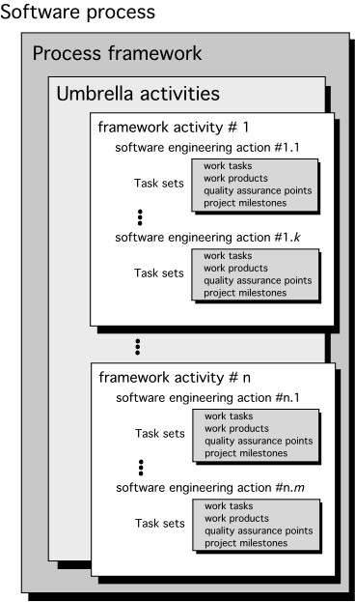
A Generic Process Model
These slides are designed to accompany Software Engineering: A Practitioner’s Approach, 8/e
(McGraw-Hill, 2014). Slides copyright 2014 by Roger Pressman.

Slide 8
Framework Activities
■
■
■
Communication Planning Modeling
Analysis of requirements Design
■
■
Construction
Code generation
Testing
■
Deployment
These slides are designed to accompany Software Engineering: A Practitioner’s Approach, 8/e
(McGraw-Hill 2014). Slides copyright 2014 by Roger Pressman.

Slide 9
Umbrella Activities
Software project tracking and control
Risk management
Software quality assurance
Technical reviews
Measurement
Software configuration management
Reusability management
Work product preparation and production
These slides are designed to accompany Software Engineering: A Practitioner’s Approach, 8/e
(McGraw-Hill 2014). Slides copyright 2014 by Roger Pressman.

Slide 10
Adapting a Process Model
Overall flow of activities, actions, and tasks and the interdependencies among them
Degree to which actions and tasks are defined within each framework activity
Degree to which work products are identified and required
Manner which quality assurance activities are applied
the manner in which project tracking and control activities are applied
Overall degree of detail and rigor with which the process is described
Degree to which the customer and other stakeholders are involved with the project
Level of autonomy given to the software team
the degree to which team organization and roles are prescribed
These slides are designed to accompany Software Engineering: A Practitioner’s Approach, 8/e
(McGraw-Hill 2014). Slides copyright 2014 by Roger Pressman.

Slide 11
The Essence of Practice
Polya suggests:
  Understand the problem (communication and analysis).
  Plan a solution (modeling and software design).
  Carry out the plan (code generation).
  Examine the result for accuracy (testing and quality assurance).
These slides are designed to accompany Software Engineering: A Practitioner’s Approach, 8/e
(McGraw-Hill 2014). Slides copyright 2014 by Roger Pressman.

Slide 12
Understand the Problem
Who has a stake in the solution to the problem? That is, who are the stakeholders?
What are the unknowns? What data, functions, and features are required to properly solve the problem?
Can the problem be compartmentalized? Is it possible to represent smaller problems that may be easier to understand?
Can the problem be represented graphically? Can an analysis model be created?
These slides are designed to accompany Software Engineering: A Practitioner’s Approach, 8/e
(McGraw-Hill 2014). Slides copyright 2014 by Roger Pressman.

Slide 13
Plan the Solution
Have you seen similar problems before? Are there patterns that are recognizable in a potential solution? Is there existing software that implements the data, functions, and features that are required?
Has a similar problem been solved? If so, are elements of the solution reusable?
Can subproblems be defined? If so, are solutions readily apparent for the subproblems?
Can you represent a solution in a manner that leads to effective implementation? Can a design model be created?
These slides are designed to accompany Software Engineering: A Practitioner’s Approach, 8/e
(McGraw-Hill 2014). Slides copyright 2014 by Roger Pressman.

Slide 14
Carry Out the Plan
Does the solution conform to the plan? Is source code traceable to the design model?
Is each component part of the solution provably correct? Has the design and code been reviewed, or better, have correctness proofs been applied to algorithm?
These slides are designed to accompany Software Engineering: A Practitioner’s Approach, 8/e
(McGraw-Hill 2014). Slides copyright 2014 by Roger Pressman.

Slide 15
Examine the Result
Is it possible to test each component part of the solution? Has a reasonable testing strategy been implemented?
Does the solution produce results that conform to the data, functions, and features that are required? Has the software been validated against all stakeholder requirements?
These slides are designed to accompany Software Engineering: A Practitioner’s Approach, 8/e
(McGraw-Hill 2014). Slides copyright 2014 by Roger Pressman.

Slide 16
Hooker’s General Principles
1: The Reason It All Exists
2: KISS (Keep It Simple, Stupid!)
3: Maintain the Vision
4: What You Produce, Others Will Consume
5: Be Open to the Future
6: Plan Ahead for Reuse
7: Think!
These slides are designed to accompany Software Engineering: A Practitioner’s Approach, 8/e
(McGraw-Hill 2014). Slides copyright 2014 by Roger Pressman.

Slide 17
Software Myths
Affect managers, customers (and other non-technical stakeholders) and practitioners
Are believable because they often have elements of truth,
but …
Invariably lead to bad decisions,
therefore …
Insist on reality as you navigate your way through software engineering
These slides are designed to accompany Software Engineering: A Practitioner’s Approach, 8/e
(McGraw-Hill 2014). Slides copyright 2014 by Roger Pressman.

Slide 18
How It All Starts
SafeHome:
  Every software project is precipitated by some business need—
    the need to correct a defect in an existing application;
    the need to adapt a ‘legacy system’ to a changing business environment;
    the need to extend the functions and features of an existing application, or
    the need to create a new product, service, or system.
These slides are designed to accompany Software Engineering: A Practitioner’s Approach, 8/e
(McGraw-Hill 2014). Slides copyright 2014 by Roger Pressman.

